Slide 1
D.A.C DATASTORE
SALES ANALYSIS
DESIGNED
BY
OGINNI O. ADEKOLA

Slide 2
Introduction
D.AC. DATASTORE is an offline retail stores where customers purchase products across the following categories across various cities in India:
Electronics
Footwear
Clothing
Home Appliances
Accessories
Kitchenware
Bags
Personal Care Products

Slide 3
Problem Statement
To uncover opportunities to improve profitability is so challenging and without a data-driven analysis of sales trends, product demand, and promotion performance, decision-makers may struggle to allocate resources effectively and maximize opportunities for business growth.

Slide 4
Key Questions to Answer
Show the top 5 and bottom 5 products based on sales, profit, or quantity sold.
Show how sales change over time — daily, monthly, quarterly, and yearly trends.
Show the relationship between sales and profit.
Compare sales, profit, and quantity sold between any two time periods the user picks.
Show the average discount given for each discount category.
Show the total number of orders.
Show all order details like sales, profit, discount, net sales, and other fields. Users should be able to filter this by product, date, customer ID, and promotion categories.
Show sales broken down by different cities.

Slide 5
Objectives
To analyze overall sales performance and trends across all products.
To identify best promotion category to increase sales and profitability.
To identify the best-demanding and least-demanding products.
To identify opportunities to increase sales and profitability.

Slide 6
Data Overview
Table 1
Table 2
Table 3
Table 4
Dim Customer:
7 Columns
50 Records
Dim Product:
4 Columns
30 Records
Dim Promotion:
6 Columns
5 Records
Fact Table:
12 Columns
3510 Records
Key Fields:
Customer ID
Customer Name
City
State
Key Fields:
Product ID
Product Name
Product Line
Price
Key Fields:
Promotion ID
Promotion Name
Promotion Percentage
Key Fields:
Date
Units Sold
Total Sales
Discount Value
Net Sales
Profit

Slide 7
Methodology
Data Collection
Sales and promotional data were obtained from the company's transactional database, containing information on product sales, promotion categories, and sales periods.
Data Cleaning and Preparation
The dataset was cleaned to ensure accuracy and consistency by:
Removing duplicate records.
Handling missing or incomplete values.
Correcting datatype.
Validating data quality and integrity
Data Transformation
The cleaned data was transformed into a suitable format for analysis by creating calculated fields and key performance indicators (KPIs).
Interactive dashboards and visualizations were also created using analytical tools to answer the key questions.

Slide 8
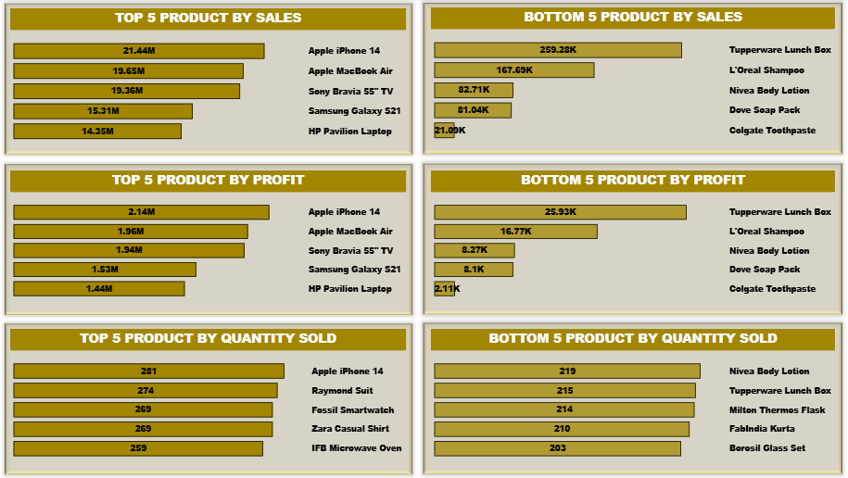
Visualization and Dashboard
5 Top-Bottom Analysis

Slide 9
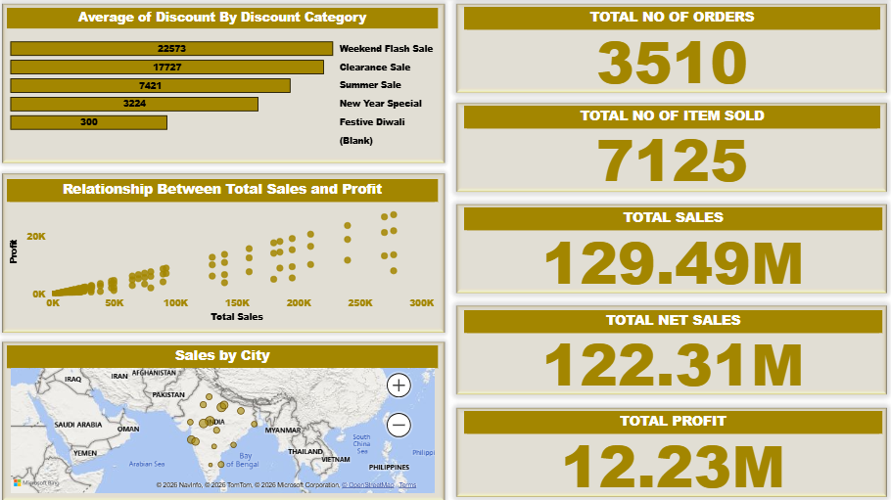
Visualization and Dashboard
Market Overview

Slide 10
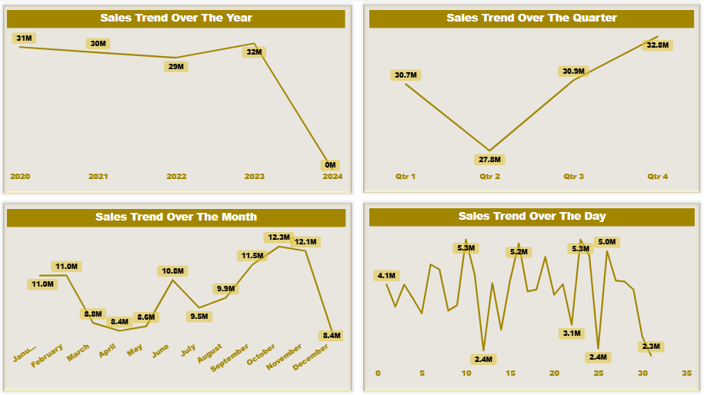
Visualization and Dashboard
Market Overview

Slide 11
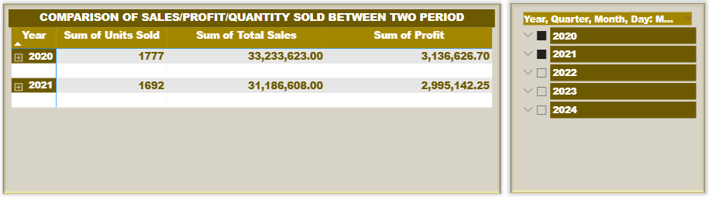
Visualization and Dashboard
Market Overview

Slide 12
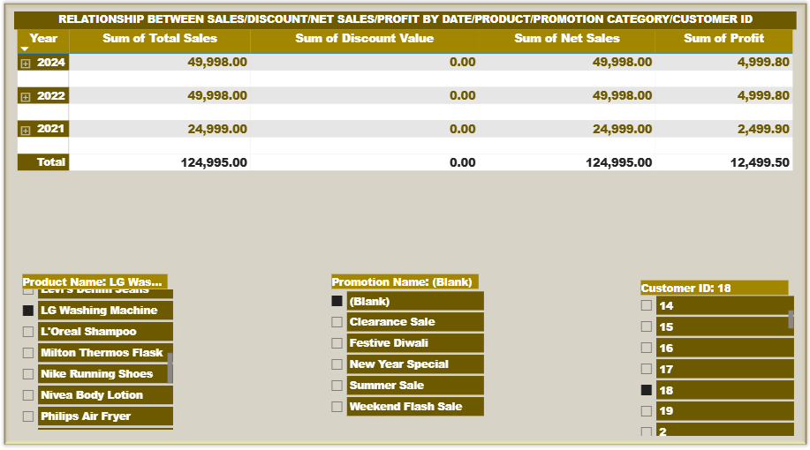
Visualization and Dashboard
Market Overview

Slide 13
Key Insight
Promotional campaigns significantly boosted sales performance.
There is more profit margin on electronics products compare to any other products.
The least demand product is personal care products.
There is always peak sales at 4th quarter of the year.

Slide 14
Conclusion
The analysis shows that promotional campaigns were highly effective in driving sales growth across the cities. Electronics products consistently outperformed all other products in revenue generated; therefore, the business should continue leveraging on promotions, prioritize high-performing products electronics, clothing and home appliances and strategically prepare for increased demand during the fourth quarter to maximize sales and profitability.

Slide 15
Tool Used
Power Bi
Dashboard Design Technique
Slicer
Chart Map
Card

Slide 16
THANK YOU

